Slide 1
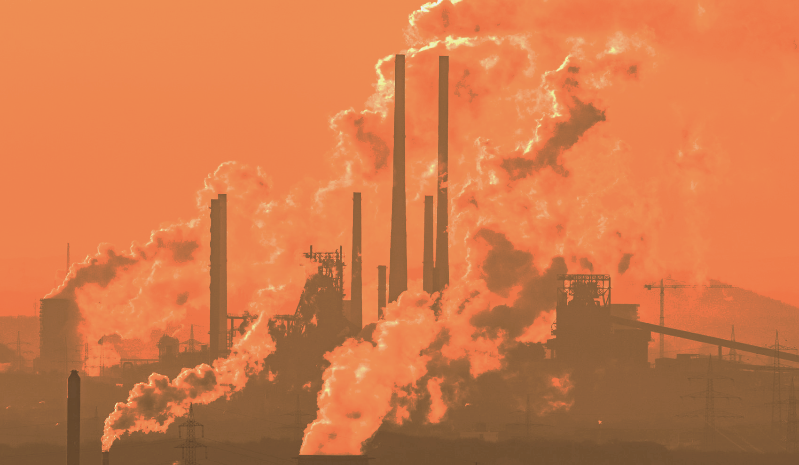
American Belief in Climate Change
Qinghao Chen, Marc Estevadeordal, Jason Ng, Carlos Toe
STAT-415/615

Slide 2
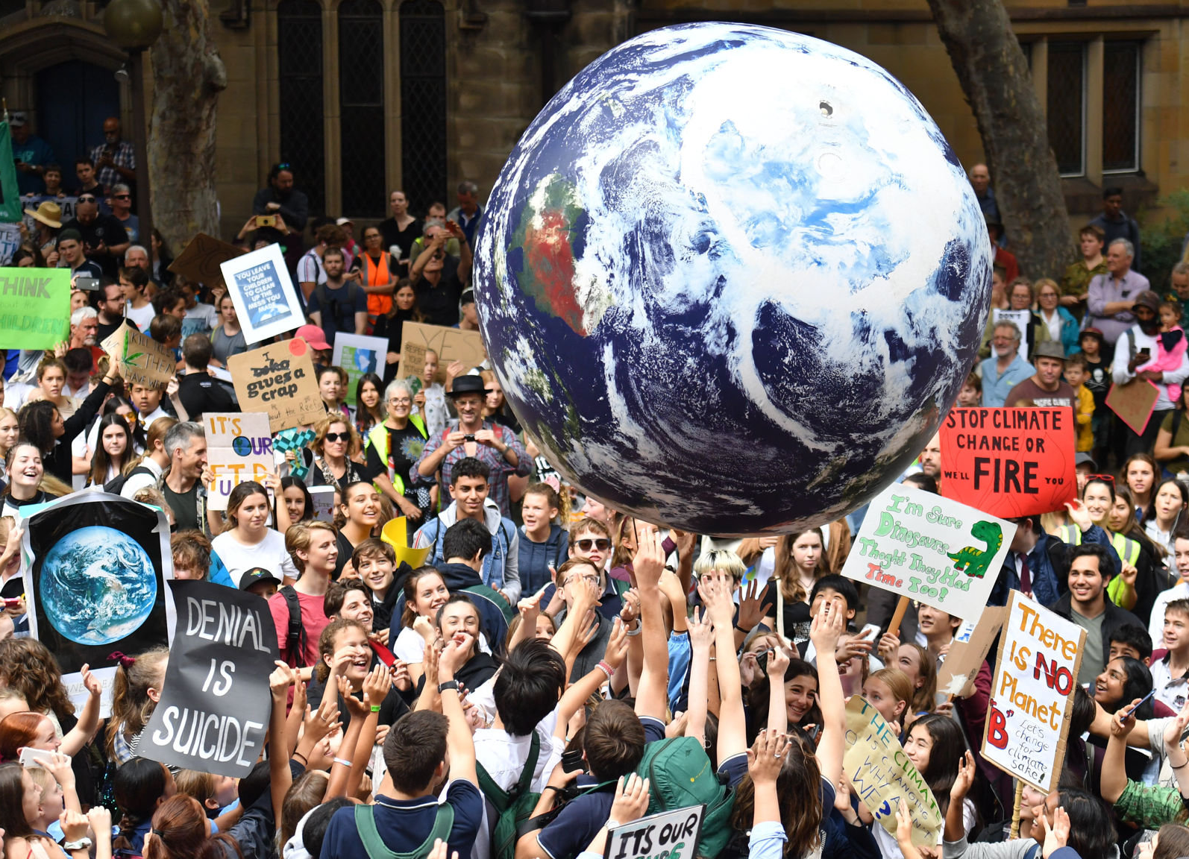
Introduction
Fewer than half of all Americans believe that climate change is due to human activity.
More than 20% of Americans do not believe that climate change is occurring at all.
What factors influence American belief in climate change?
Notes:
CARLOS
Climate change is an existential threat to human health and the ecosystem.
Despite near universal consensus among scientists that climate change is occurring and caused by humans, one poll found that fewer than half of all Americans believe that climate change is due to human activity.
More concerning, more than 20% of Americans do not believe that climate change is occurring at all.

Slide 3
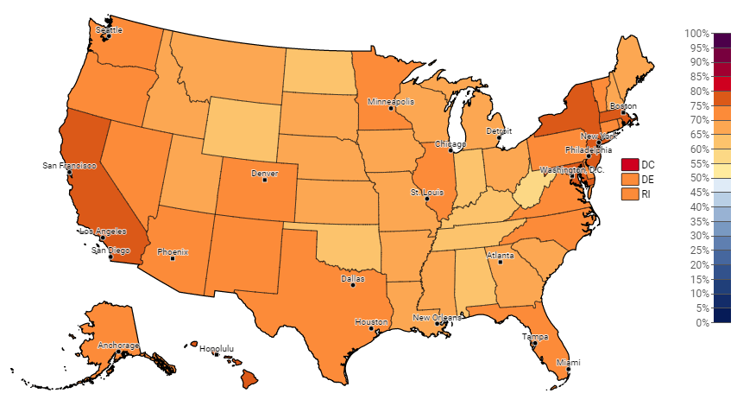
Variables
What might influence belief in climate change in the US?
Estimated % of adults who think global warming is happening, 2020
Response Variable:
% of adults who think global warming is happening
Predictor Variable(s):
Political party affiliation
Weather and climate disasters (with losses exceeding $1 billion)
Educational attainment (bachelor's’ degree or higher)
Notes:
CARLOS
Estimated % of adults who think global warming is happening - Yale Climate Opinion Maps 2020
Political party affiliation - Cook Partisan Voting Index (PVI)
Weather and climate disasters (with losses exceeding $1 billion) - NOAA National Centers for Environmental Information
Educational attainment (bachelor's’ degree or higher) - U.S. Census Bureau

Slide 4




Data Sources
Yale Climate Opinion Maps 2020 - (perBelief)
estimated % of adults who think global warming is happening
public opinion survey about global warming, collected spring 2020
Cook Partisan Voting Index - (PVI)
measurement of how strongly a state leans toward the Democratic or Republican Party (compared to the nation as a whole), e.g. Vermont D+15, Wyoming R+26
results based on results from 2016 and 2020 elections
Billion-Dollar Weather and Climate Disasters - (disEvents)
weather and climate disasters where overall damages/costs reached or exceeded $1 billion, using events that occurred 2019-2020
Educational Attainment: Bachelor's Degree or higher - (perBachelor)
populations' educational attainment for all people of at least 25 years of age
U.S. Census Bureau's American Community Survey in 2019
Notes:
MARC

Slide 5
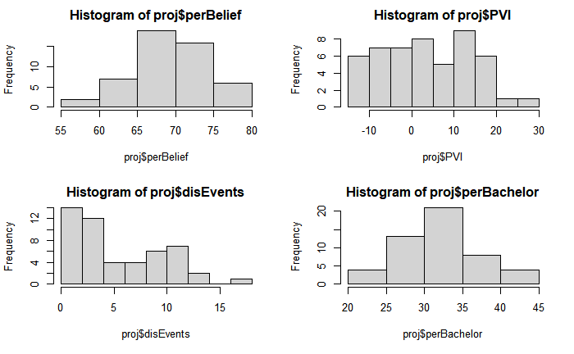
Exploratory Data Analysis
Notes:
KEVIN:
With regard to have a general idea what is the performance of this model is, just like what we did in every homework throughout this semester
limitation of data set for hist_2

Slide 6
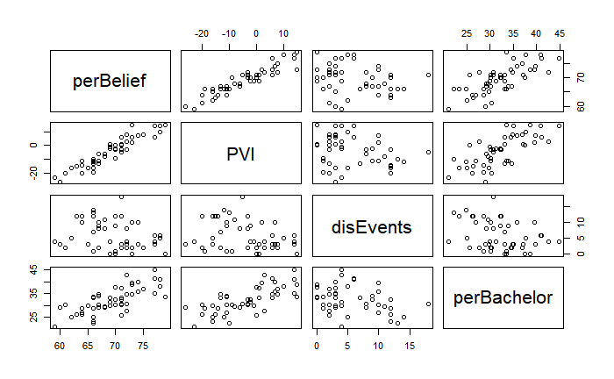
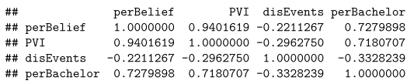
Exploratory Data Analysis
Notes:
KEVIN, per-percent dis-disastrous

Slide 7
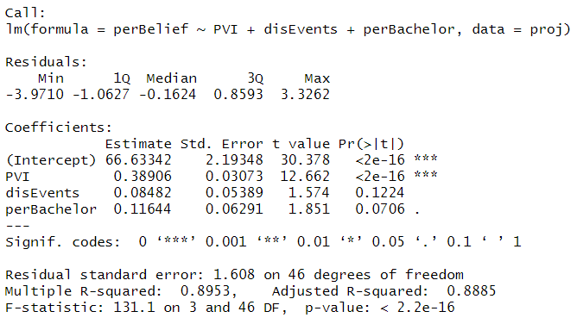
Model
Notes:
KEVIN

Slide 8
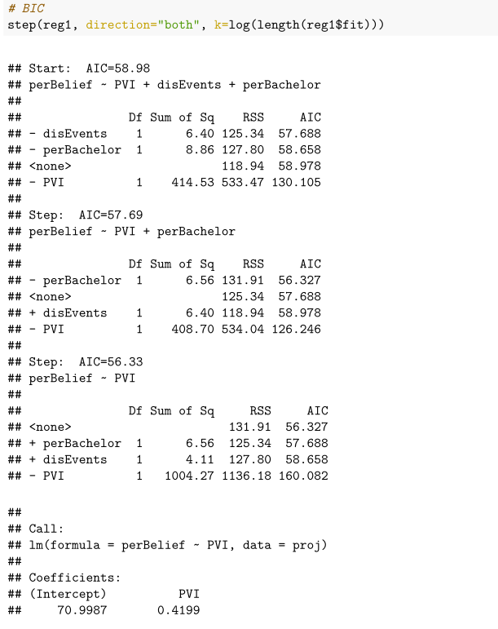
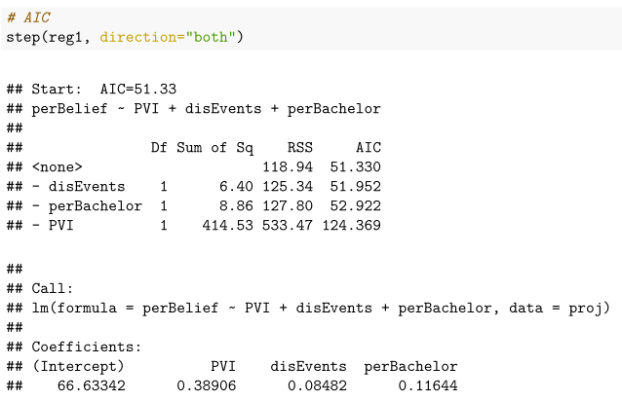
Variable Selection
(Stepwise)
Notes:
JASON

Slide 9
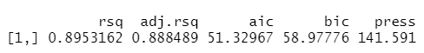
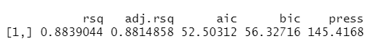
Model Selection - Comparison
(from AIC stepwise)
(from BIC stepwise)
Notes:
JASON
• Look for models with smaller AIC or SBC.
• SBC is also known as the Bayesian Information Criterion (BIC).
• There is a trade-off between model fitness (SSE) and complexity (p).
• SBC (BIC) tends to select “smaller” model than AIC does because SBC (BIC) penalizes the model complexity (p) more heavily. Why?
Despite the tendency that AIC tends to overfit models but SBC underfits models. We still chose the above model for the sake of project completion.

Slide 10
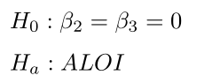
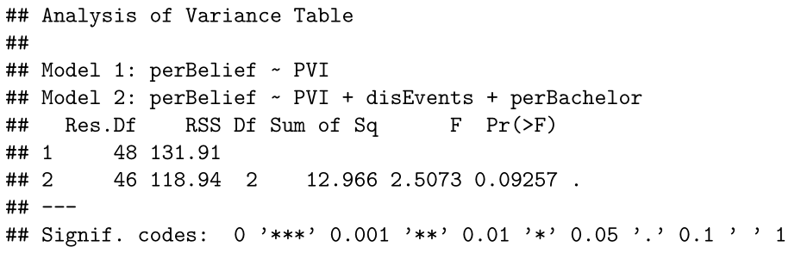
ANOVA
Notes:
CARLOS

Slide 11
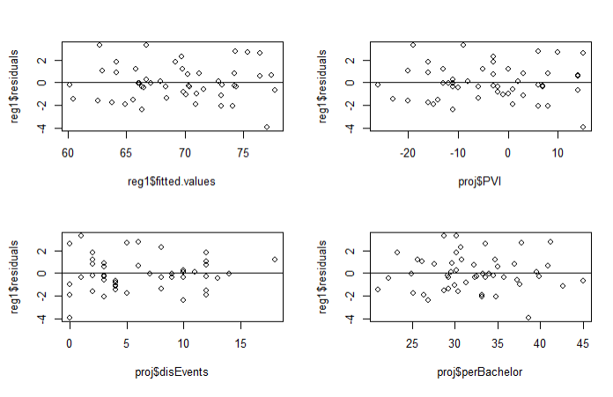
Residuals
Notes:
CARLOS

Slide 12
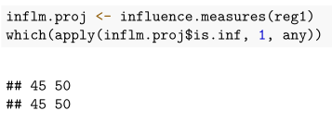
Influential Cases
Notes:
MARC

Slide 13
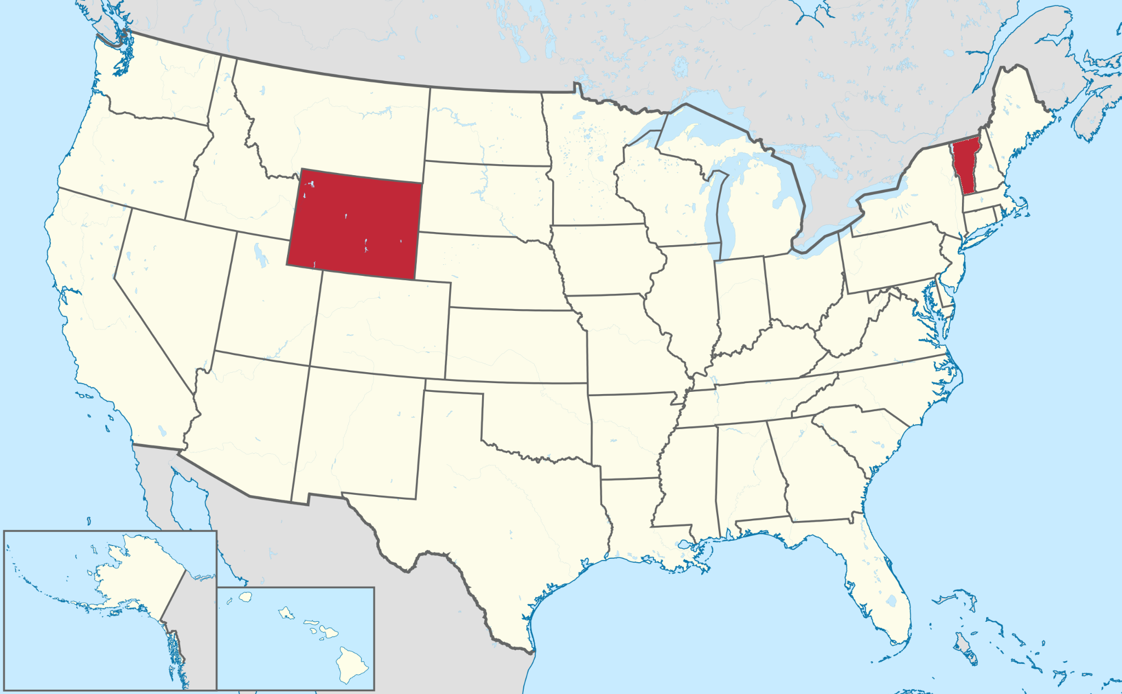
Influential Cases
Wyoming and Vermont
Most Republican & Democratic leaning states (respectively)
Notes:
MARC

Slide 14
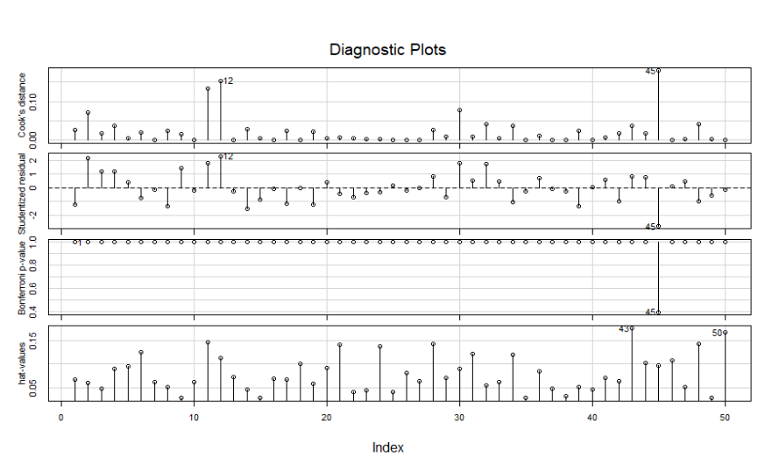
Diagnostics
Notes:
JASON

Slide 15
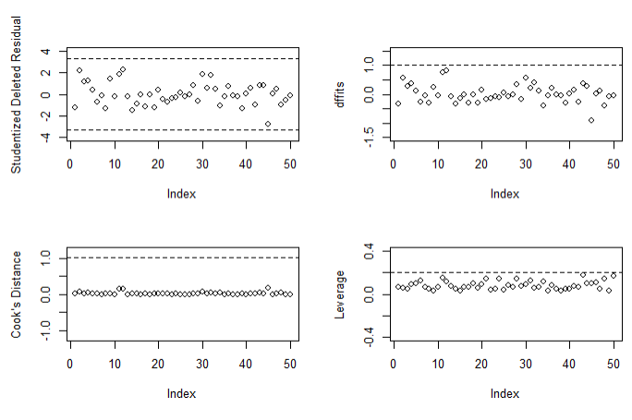
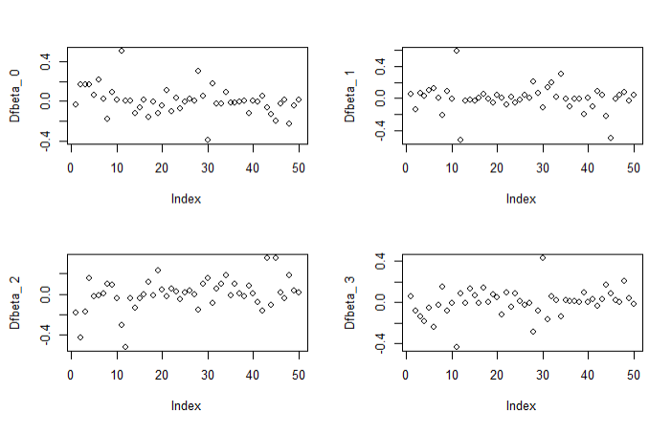
Diagnostics
Notes:
JASON

Slide 16
Conclusions
Political lean/affiliation appears to be the dominant predictor for American belief in climate change
Disaster events and/or bachelor’s degree may not appear to have a significant effect on climate change belief (but may need to revise research question/models to assess this further)
Notes:
KEVIN

Slide 17
Limitations
Opportunities
Small dataset
High association with political affiliation
More variables to be considered?
Could have considered control variables and/or interactions
In-depth analysis for political affiliations and specific climate policies
Account for political nuances, local economies, variety for disasters
Test more than belief; i.e. support for policies like a carbon tax, individual behaviors
Notes:
MARC

Slide 18
References
Yale Climate Opinion Maps 2020 https://climatecommunication.yale.edu/visualizations-data/ycom-us/
Cook Partisan Voting Index https://en.wikipedia.org/wiki/Cook_Partisan_Voting_Index
NOAA National Centers for Environmental Information https://www.ncdc.noaa.gov/billions/
U.S. Census Bureau, American Community Survey https://en.wikipedia.org/wiki/List_of_U.S._states_and_territories_by_educational_attainment

